Slide 1
Inteligent Talent Acquisition System Project Review
Prepared By:
Darshan Pathak

Slide 2
Facts
250
2%
0.4%
42
20 lakh
In the todays competitive job market a single job attracts over 250 applications.
Up to Six of these candidates will get shortlisted for an interview
Through this entire process only one candidate is finalized for the job
It takes an average of 42 days to fill an open position, with more specialist roles taking up to 65 days
One bad hiring costs Indian companies over Rs20 lakh

Slide 3
Table of contents
01
05
02
06
03
04
Introduction
Methodology
Requirements
Problem Statement
07
Outcomes
Scope
08
Objectives
Conclusion

Slide 4
01
Introduction

Slide 5
Introduction
Simplifying hiring with advanced tech. Deep learning assesses candidates, machine learning provides recommendations, making hiring easier, more accurate, and friendlier for everyone involved

Slide 6
02
Problem Statement

Slide 7
Existing System Overview
Manual Resume Screening
Manual Interview Scheduling
Manual resume reviews are time-consuming and may overlook qualified candidates due to human biases.
Manual interview scheduling leads to communication issues, causing conflicts and delays in the process.
Lack of Predictive Analytics
Limited Skill Matching
Manual skill-to-job matching lacks adaptability and precision, risking poor candidate-job fits.
Without predictive analytics, estimating hiring time becomes difficult, limiting effective workforce planning.

Slide 8
How iTAS Aims to Solve this Problems?
The current talent acquisition system relies on manual processes, causing issues with efficiency, accuracy, and adaptability.
Automation: Eliminates manual tasks for a more automated process.
Efficiency: Accelerates operations, reducing time-related operations.
Precision: Incorporates advanced technology to ensure accurate candidate assessments.
Adaptability: Flexibly adjusts to evolving hiring needs, enhancing overall responsiveness.
ITAS will provide an advanced system for a more efficient, accurate, and adaptable recruitment process.

Slide 9
03
Scope

Slide 10
Scope of ITAS outlining the specific goals, tasks, and boundaries, serving as a guide for project execution
Implement advanced technologies such as deep learning and machine learning for accurate resume analysis, skill matching, and automated interview scheduling. Develop secure and user-friendly dashboard to automate the hiring process, focusing on improving accuracy, efficiency, and inclusivity. The scope also includes scalability measures, and support to ensure effective hiring process.

Slide 11
04
Objectives

Slide 12
Defining Objectives
Improve Candidate Assessment:
Efficiency in Recruitment Process
Manage Data Efficiently
Ensure precise candidate evaluations by leveraging smart machine learning, minimizing errors and biases in the initial screening stage.
Simplify the process with dashboards, job postings, candidate profiles and tools to achieve efficiency
Organize data smartly for quick decisions and easy report generation within our system
Personalized Skill Matching
Fair and Inclusive Hiring Practices
Enhance User Experience
Use intelligent algorithms for skill matching, providing recruiters with suggestions to optimize candidate-job alignment.
Prioritize ethical and inclusive hiring practices to build a diverse team of talented individuals
Design interfaces and features that make the hiring journey positive and efficient for both recruiters and candidates

Slide 13
05
Methodology

Slide 14
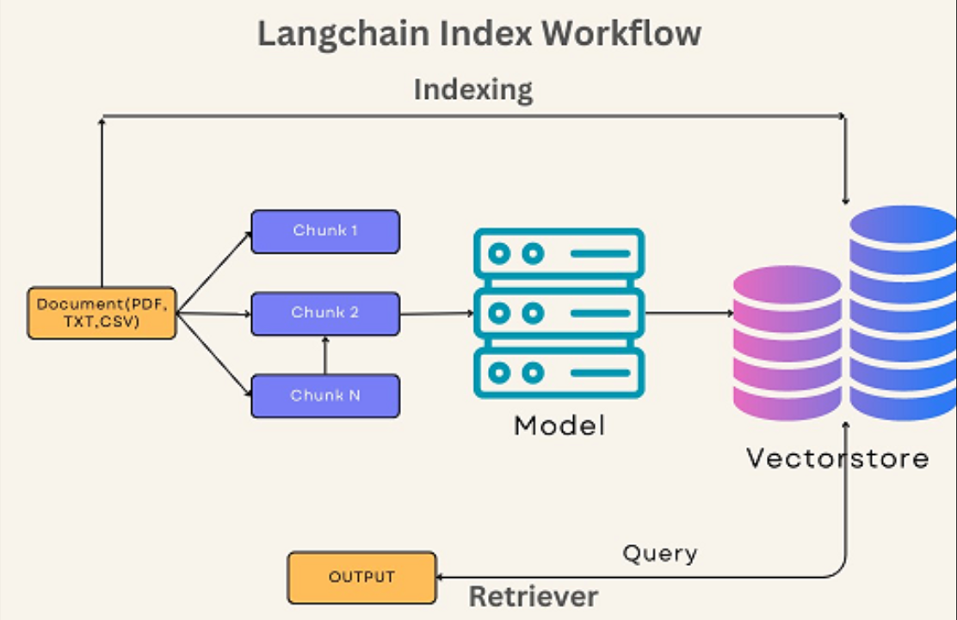
Workflow

Slide 15
5.1 Flow Diagram
Project Initiation
Project Planning
Resource Gathering
Execution
Monitoring & Adaptation
Project Submission & Evaluation

Slide 16
5.2 Functional Requirements
Accuracy
Security
Deep learning model for precise extraction of candidate information.
The system should securely manage user access, roles, and passwords for enhanced security.
Reporting & Analytics
The system should allow users to create custom reports, utilize analytics tools for insights for further improvements in the required skills.

Slide 17
5.3 Non-functional Requirements
Performance
Usablity
The system must ensure responses within fast and accurate.
The interface should be easy to use with minimal training, and the system must work on common devices and browsers for user convenience.

Slide 18
06
Technical Requirements

Slide 19
Version Control
GitHub,VScode
Programming Languages
Data Base Management
Python
SQL
MySQL
Deep Learning Frameworks
Web Development Framework
TensorFlow
PyTorch
Scikit-Learn
HTML, CSS, JavaScript, and Gradio
Jira
Notion
Project Management

Slide 20
07
Expected Outcomes

Slide 21
Expected Outcomes
Finding the right candidates
Ethical and Inclusive Hiring
Efficient Recruitment
Increased Placements Statistics
Intelligent Talent
Acquisition
System
Personalized Recommendations
Better Time and Resource Management
Secure Data Handling
Better Resume Analysis

Slide 22
08
Conclusion

Slide 23
The Intelligent Talent Acquisition System, driven by smart technology, enhances accuracy, streamlines hiring, and improves the overall experience. It ensures better matches, simplifies scheduling, and employs predictive analytics for a smarter, fairer recruitment process, marking a significant shift in how organizations approach hiring.

Slide 24
Thank You

